Slide 1

2020
1

Slide 2
Job Outcomes

Slide 3

Introduction …..
Jessica Haines
Head of Talent
Email me: Jessica.haines@institutedata.com
Book a meeting: https://app.hubspot.com/meetings/careers-advisor-iod/job-outcomes-career-coaching-call

Slide 4
Agenda
What is the Job Outcomes Program and what do I need to do?
Resume & Cover Letters
IOD Job Board
Social Media for Job Searching
Understanding your Digital Footprint
LinkedIn Profile
Job Search Using LinkedIn
Growing your Network
Be Proactive - Top 20
Interview Preparation & Execution
Dress Code
Follow up Emails
Internships & Volunteering
Salary Negotiation
Networking & Hiring Events
Mentors
Job and event tracking sheet

Slide 5
By the end of this first session you will have …..
Signed up to the IOD jobs board
Written s professional summary using the BAGS framework
Add skills to your linkedin
Add your Professional Certificate with IOD to your linkedin
Connected with all Peers in the class on your linkedin
Endorse all Peers in the class for the course related skills
Add your current CV and cover letter in the JO folder
Start your top 20 employer wishlist the job tracking sheet

Slide 6
What is the Job Outcomes Program?
Job Outcomes Program is an Institute of Data initiative where we provide coaching and guidance to assist our students in securing employment.
We offer two in class sessions as well as 1:1 coaching calls that you can book at any time using this link https://app.hubspot.com/meetings/careers-advisor-iod/job-outcomes-career-coaching-call

Slide 7
What do I need to do?
In order to achieve your career objectives, we set the same basic activity goals for everyone in the program
10+ Job applications per week. Remember you don't have to be an exact match to apply for a role. If you meet 70% of the requirements apply!
4+ events attended per month. In the current market there are a range of online events as well as in person. At these events, you will have the opportunity to meet prospective employers and industry professionals that could support you in your career.
20+ target employers. Start to build relationships with prospective employers. Create a list of 20 employees that you would like to work for in your Job Outcomes Tracking Sheet and then research key contacts. Additionally you have access to the IOD Industry Database.

Slide 8
IMDA Job Outcome Examples
1
Employment Contract & JD
Full-time Job 5 Days a Week
2
Client Contracts showing commitment to industry
Contract/ Freelance Multiple Projects
3
Business Profile on ACRA + 1 Page Consulting Profile
Starting a Business In Industry
4
Letter from Employer confirming job change
Job Change Same Employer

Slide 9
How long does a hiring manager take to read your resume?

Slide 10
How long does a hiring manager take to read your resume?
6 seconds!

Slide 11
Resume
3 pages maximum.
Contact details: Name, Mobile Number, Email, LinkedIn, Address
Summary: Not to be confused with a career objective
Technical Skills: Technical/software skills
Professional Experience
Capstone Project/ Notable Projects, Employment history, Internships, Work placements, Volunteering
Achievement Statements (for each job role or Internship)
Education/ Certifications
Institute of Data
Professional Certificate in Data Science & AI / Cyber Security
Referees: Available upon request

Slide 12
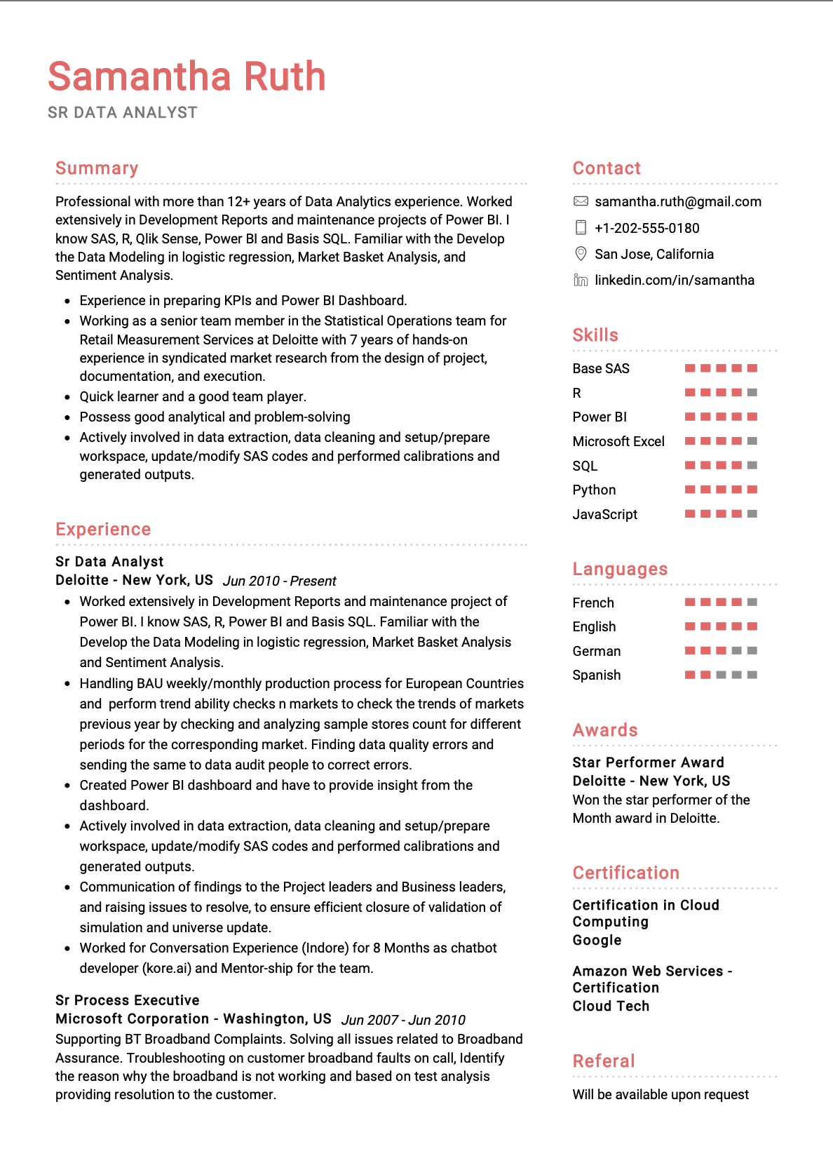

Slide 13
Keywords you could use
Data Science
Data Scientist
Big Data
Analytics
Machine Learning:
Data Mining
Hadoop
Pivotal
Visualisation
Deep Learning
Python
Business Intelligence
R Programming
NetIQ
Predictive Modeling
Clustering
Operations Research
Statistician
NoSQL
Graph Database:
Database
SQL
Excel
IoT (Internet of Things)
Data Warehouse
Data Engineer
Data Architect
API
IDAN
Data Security
Cyber Security
Security Architect
Security Engineer
Security Consultant
Security Testing
NIST
CF
HITRUST CSF
ISO 27001
Cryptography
DLP
AWS
Programming Languages
Phython
CI/CD Integration
Cloud

Slide 14
Building out your Resume and Save it to your Job Outcomes Folder

Slide 15
Cover Letter
Contact details
Name, Location, LinkedIn, Email, Phone Number, Date of application
Company
Greeting
Introduction
Body
Reasons why you want to work for the company
How your qualifications & experience could add value to them
Closing statement
Signature
Sign off with an e-signature

Slide 16
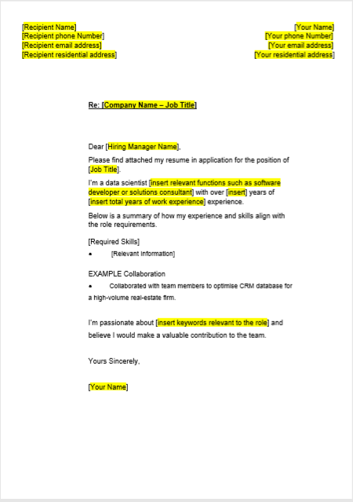

Slide 17
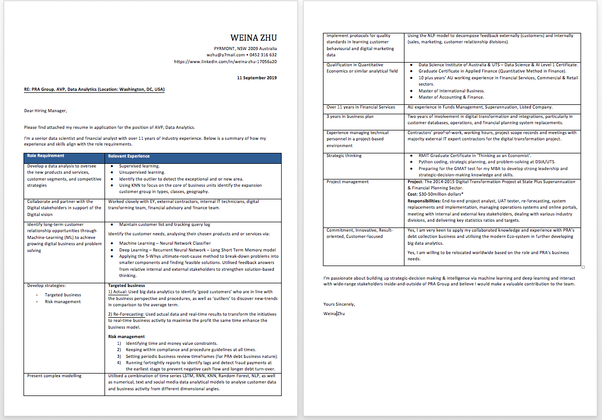

Slide 18
Building out your Cover Letter and Save it to your Job Outcomes Folder

Slide 19
IOD Job Board
Create a profile on the IOD Job Board and start getting notifications for jobs.
IOD Job Board will notify you of job availabilities!
10mins ….

Slide 20
Social Media for Job Searching

Slide 21

How can YOU use social Media for job searching?
Social media offers the opportunity to build a strong online profile that attracts recruiters and hiring managers
Create a strategy to optimise your presence by:
Use a consistent username and image across your Facebook, LinkedIn and Twitter profiles
Highlight your location – general, not specific!
Highlight the type of work you’re looking for
Follow, network and engage with:
Companies you want to work for
Recruiters who recruit people like you
Leaders in the job area you’re interested in
Groups active in the sector Set up job alerts!

Slide 22

Employers and recruiters use it too!
Recent research indicated that more than 50% of employers view candidates’ social media profiles before making a job offer.
This led to the majority of recruiters reconsidering their decision.

Slide 23

Your Digital Footprint….
Facebook profile picture
Facebook banner Facebook groups Instagram
Tumblr
Pinterest
Comment boards Forums
Flickr
YouTube
Gmail
Snapchat
School yearbook online

Slide 24

So think about your data protection
Think carefully about :
Keeping your social and professional profiles separate
Medium selection – think about what to include where!
Content selection – professional, appropriate
Privacy settings
Security

Slide 25
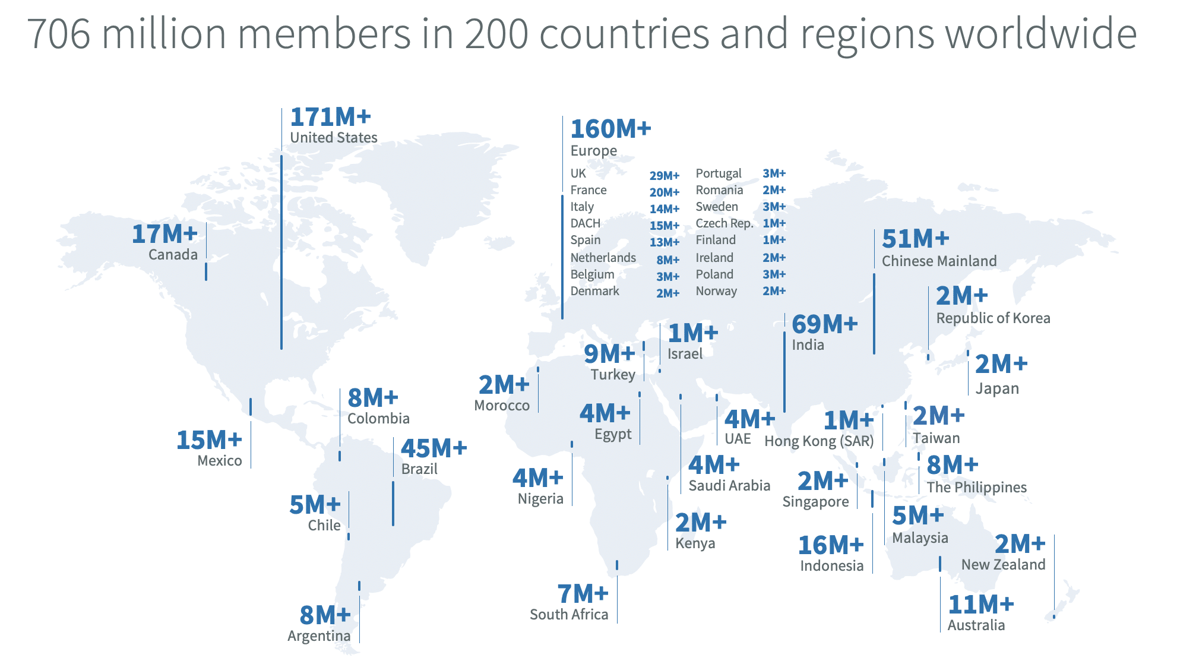
LinkedIn

Slide 26
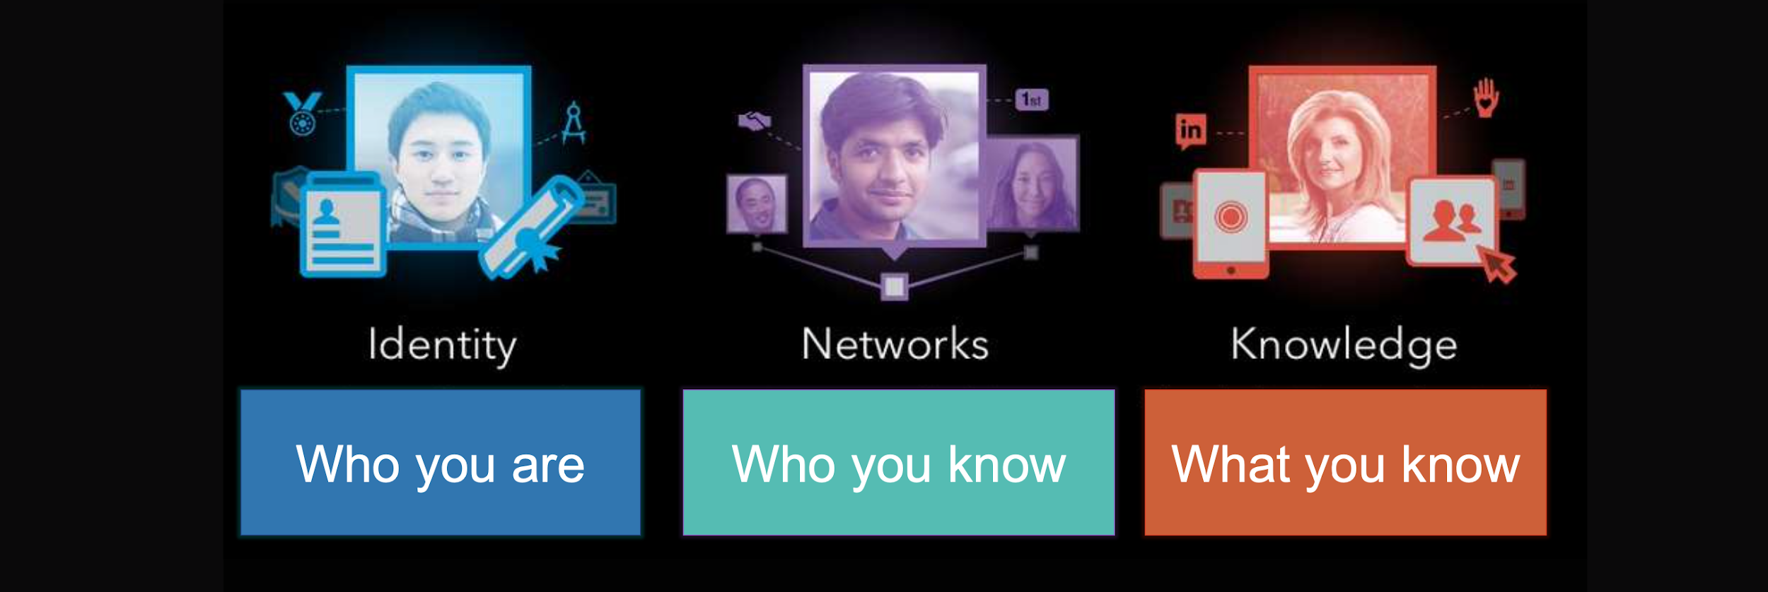
To give yourself the best chance of success
x

Slide 27

Top Tips for Job Searching with LinkedIn
Complete your profile, 100%
Build your network
Engage with your network
Share industry relevant content
Join relevant groups
Gather recommendations and endorsements
Apply for Jobs

Slide 28
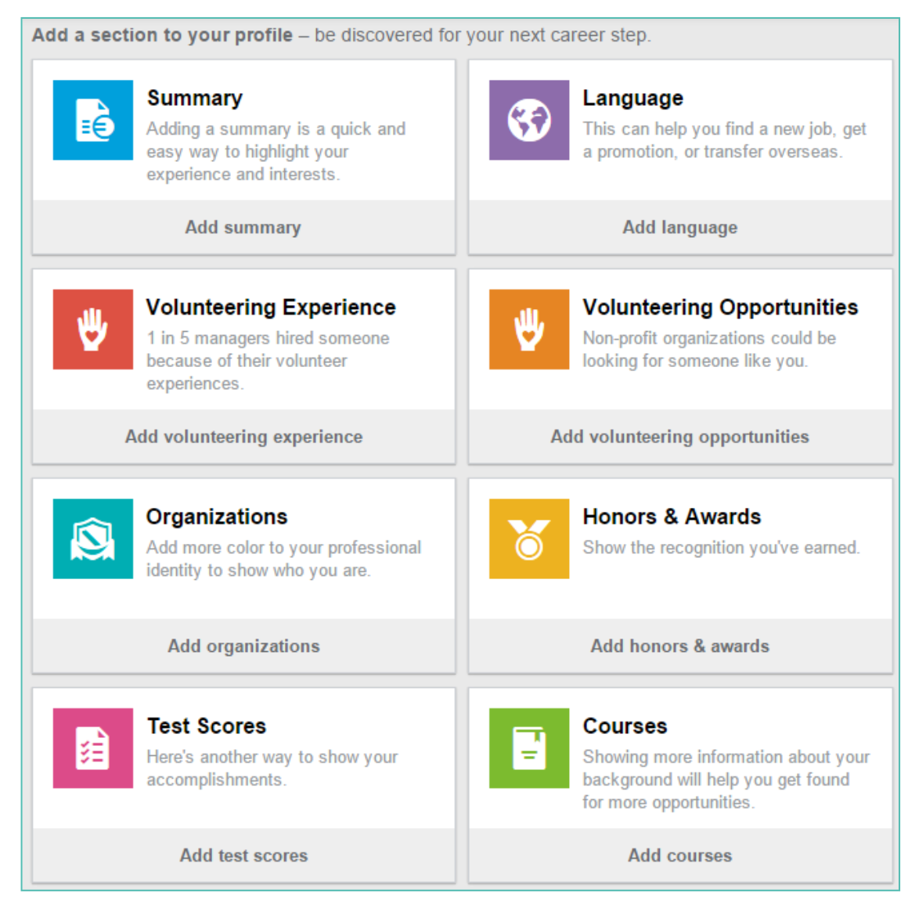
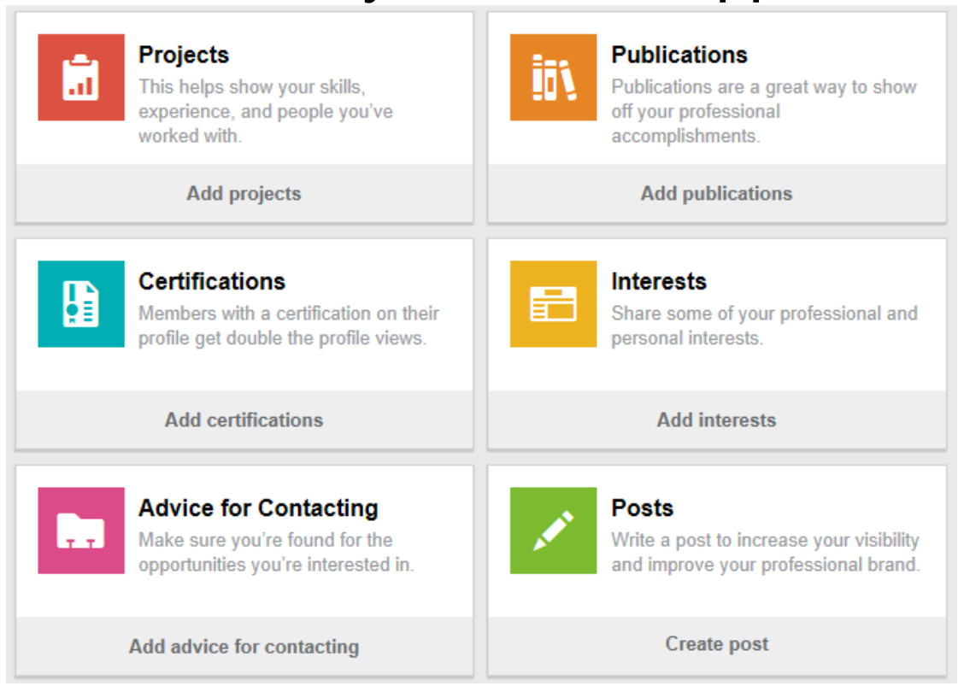
Build your Profile 100%
Update your profile on a regular basis
100% complete profiles are
40% more likely to receive opportunities

Slide 29
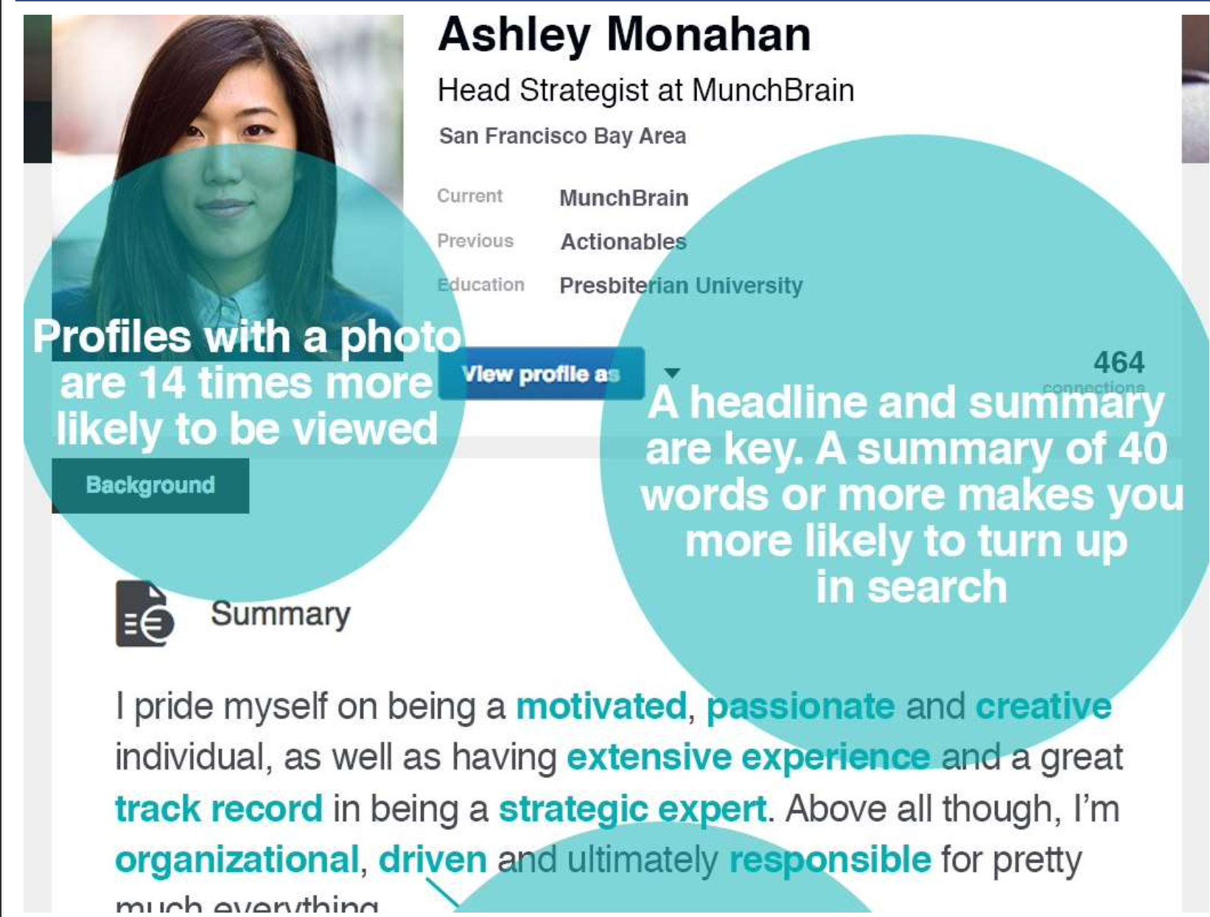
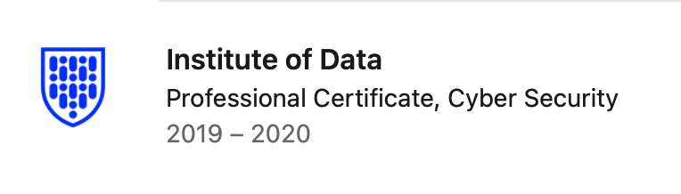

Your LinkedIn Profile
Making you more visible to potential employers and recruiters:
Professional but friendly looking photo
Write an attention grabbing headline - put that you’re job hunting
Write a compelling summary
Add your Professional Certificate with the Institute of Data

Slide 30
Building out your LinkedIn Profile

Slide 31
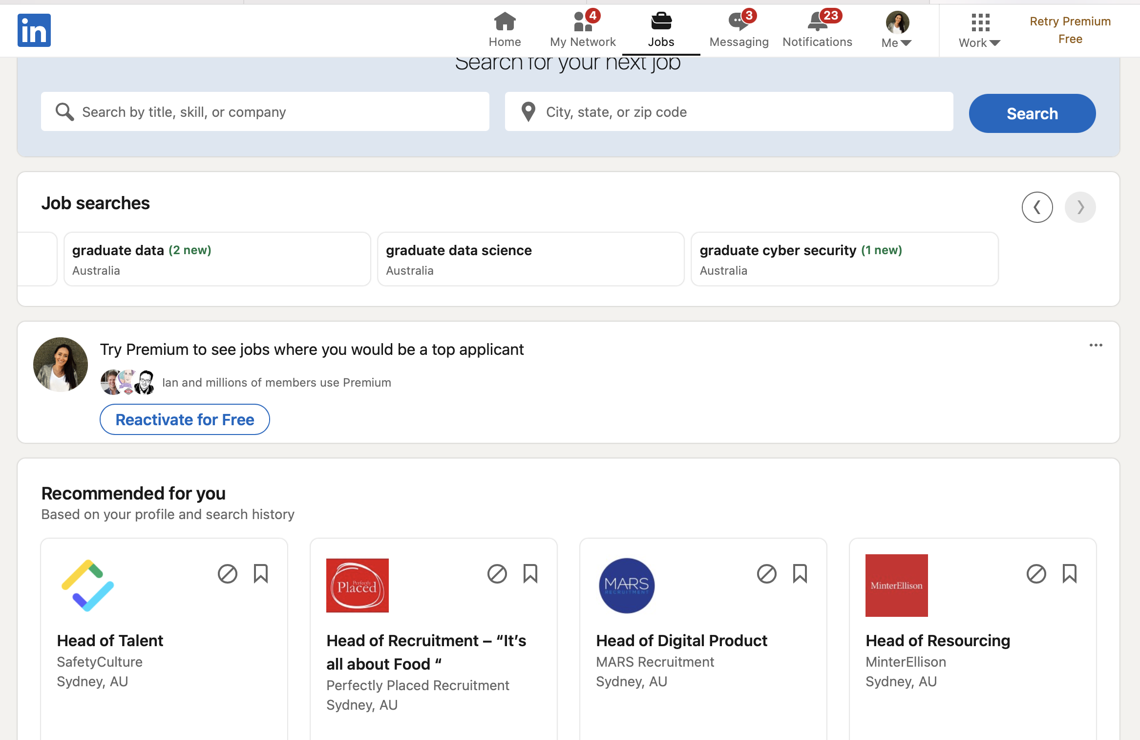
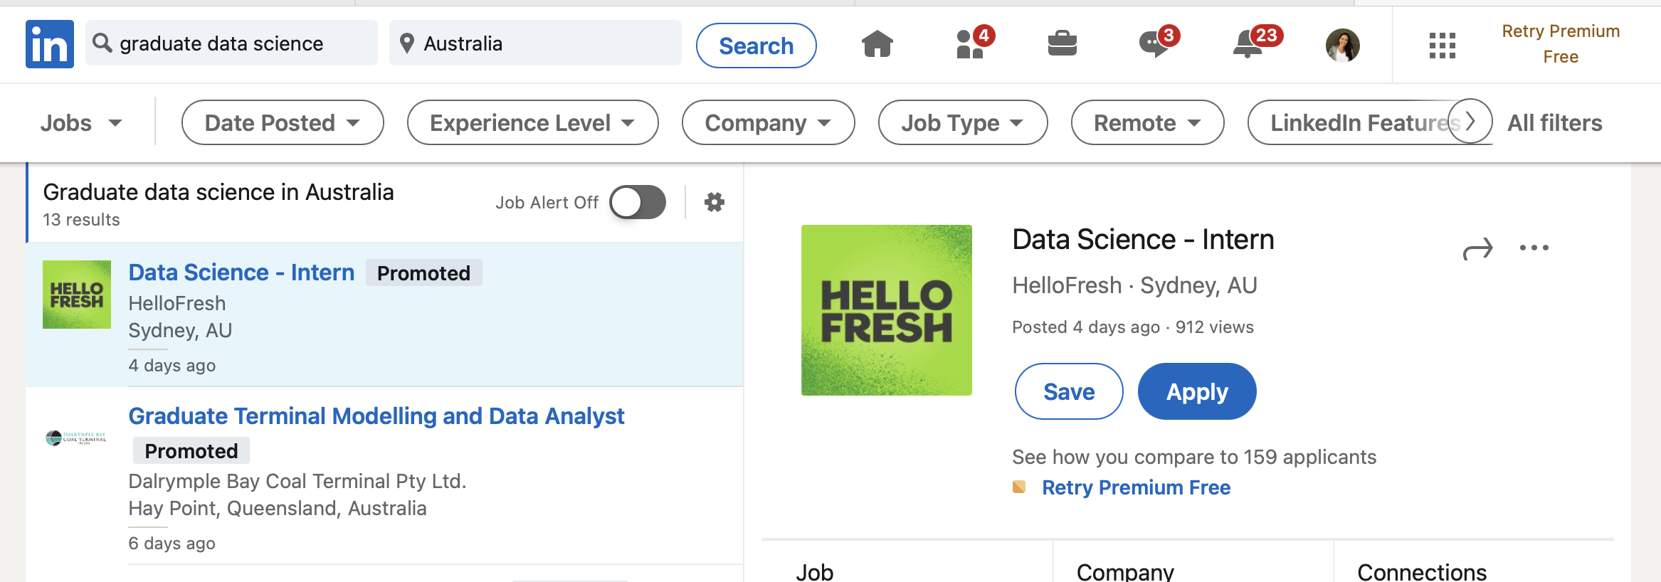
Job Searching using LinkedIn
LinkedIn will recommend jobs based on your profile and recent searches
Remember to sign up to job alerts!

Slide 32
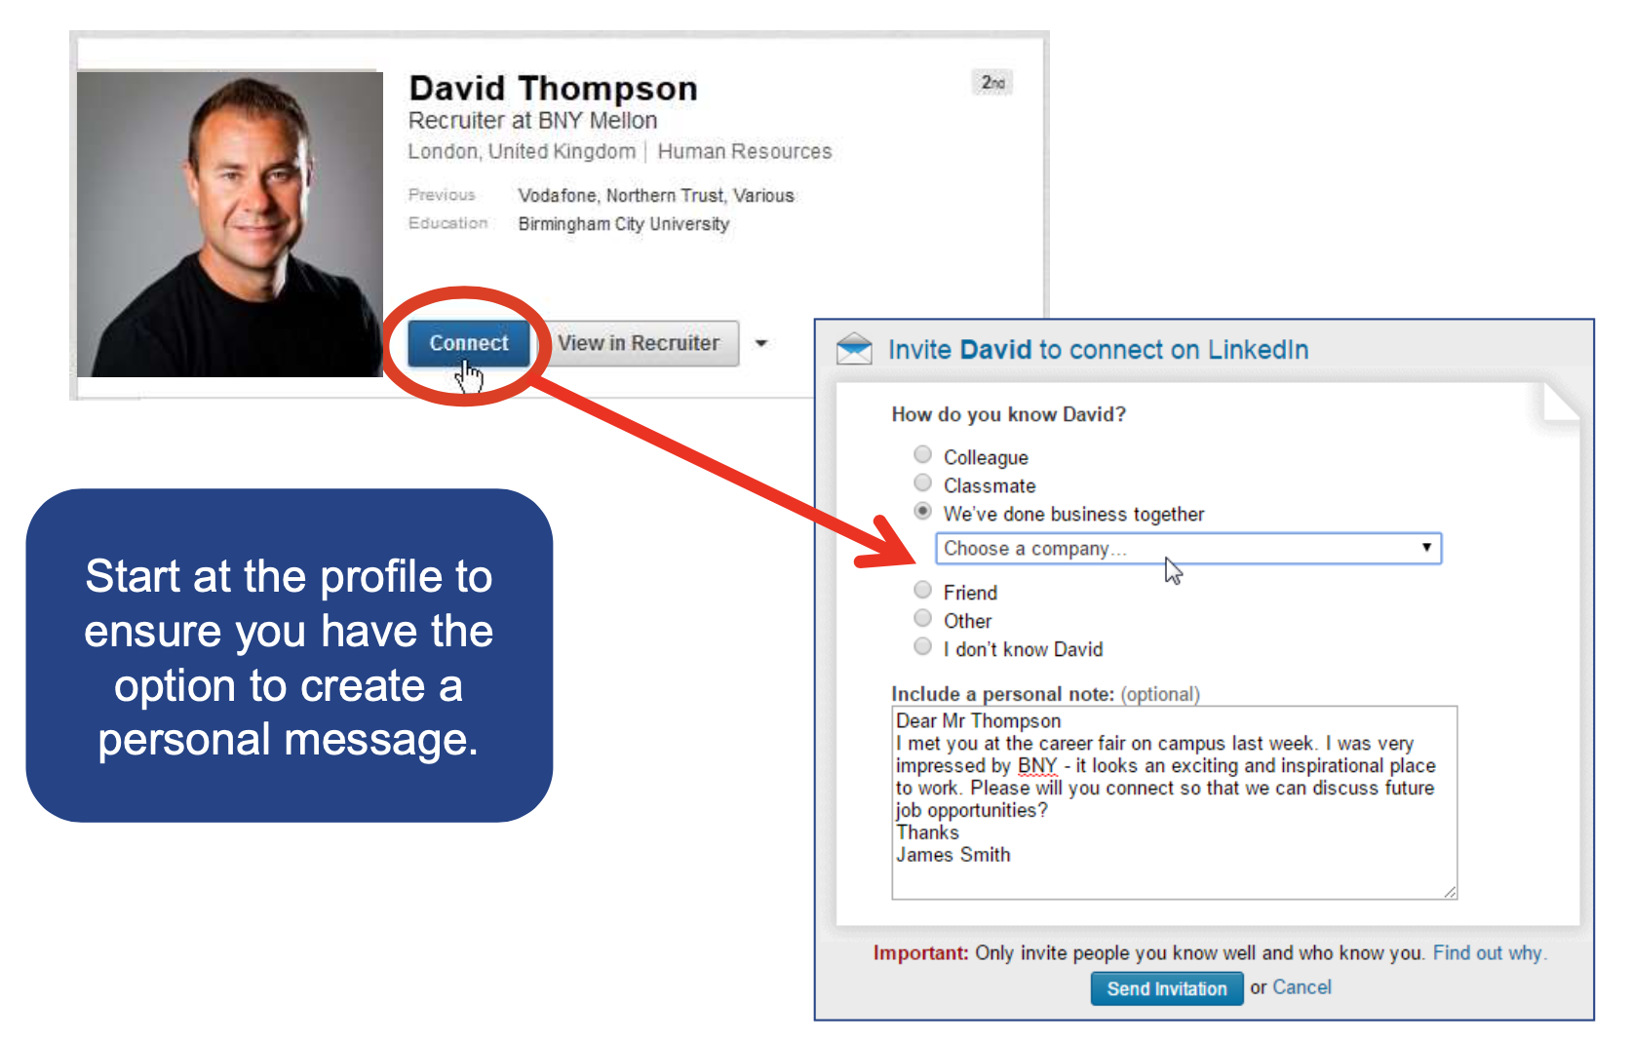
Grow your Network
Send personalized invitations with context

Slide 33
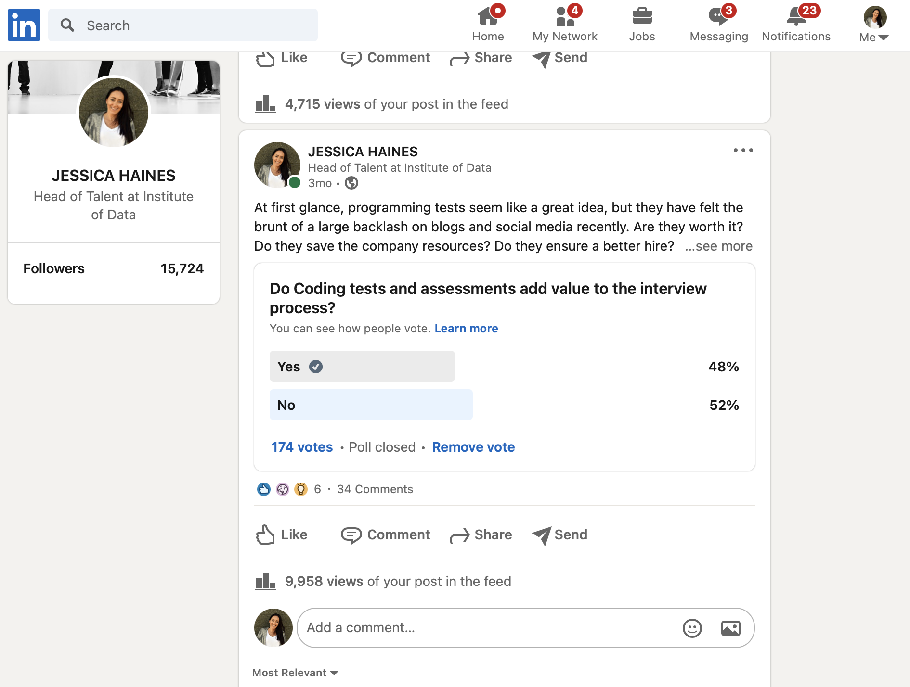
Networking using LinkedIn
Ask Questions
Build a reputation
Be seen!

Slide 34
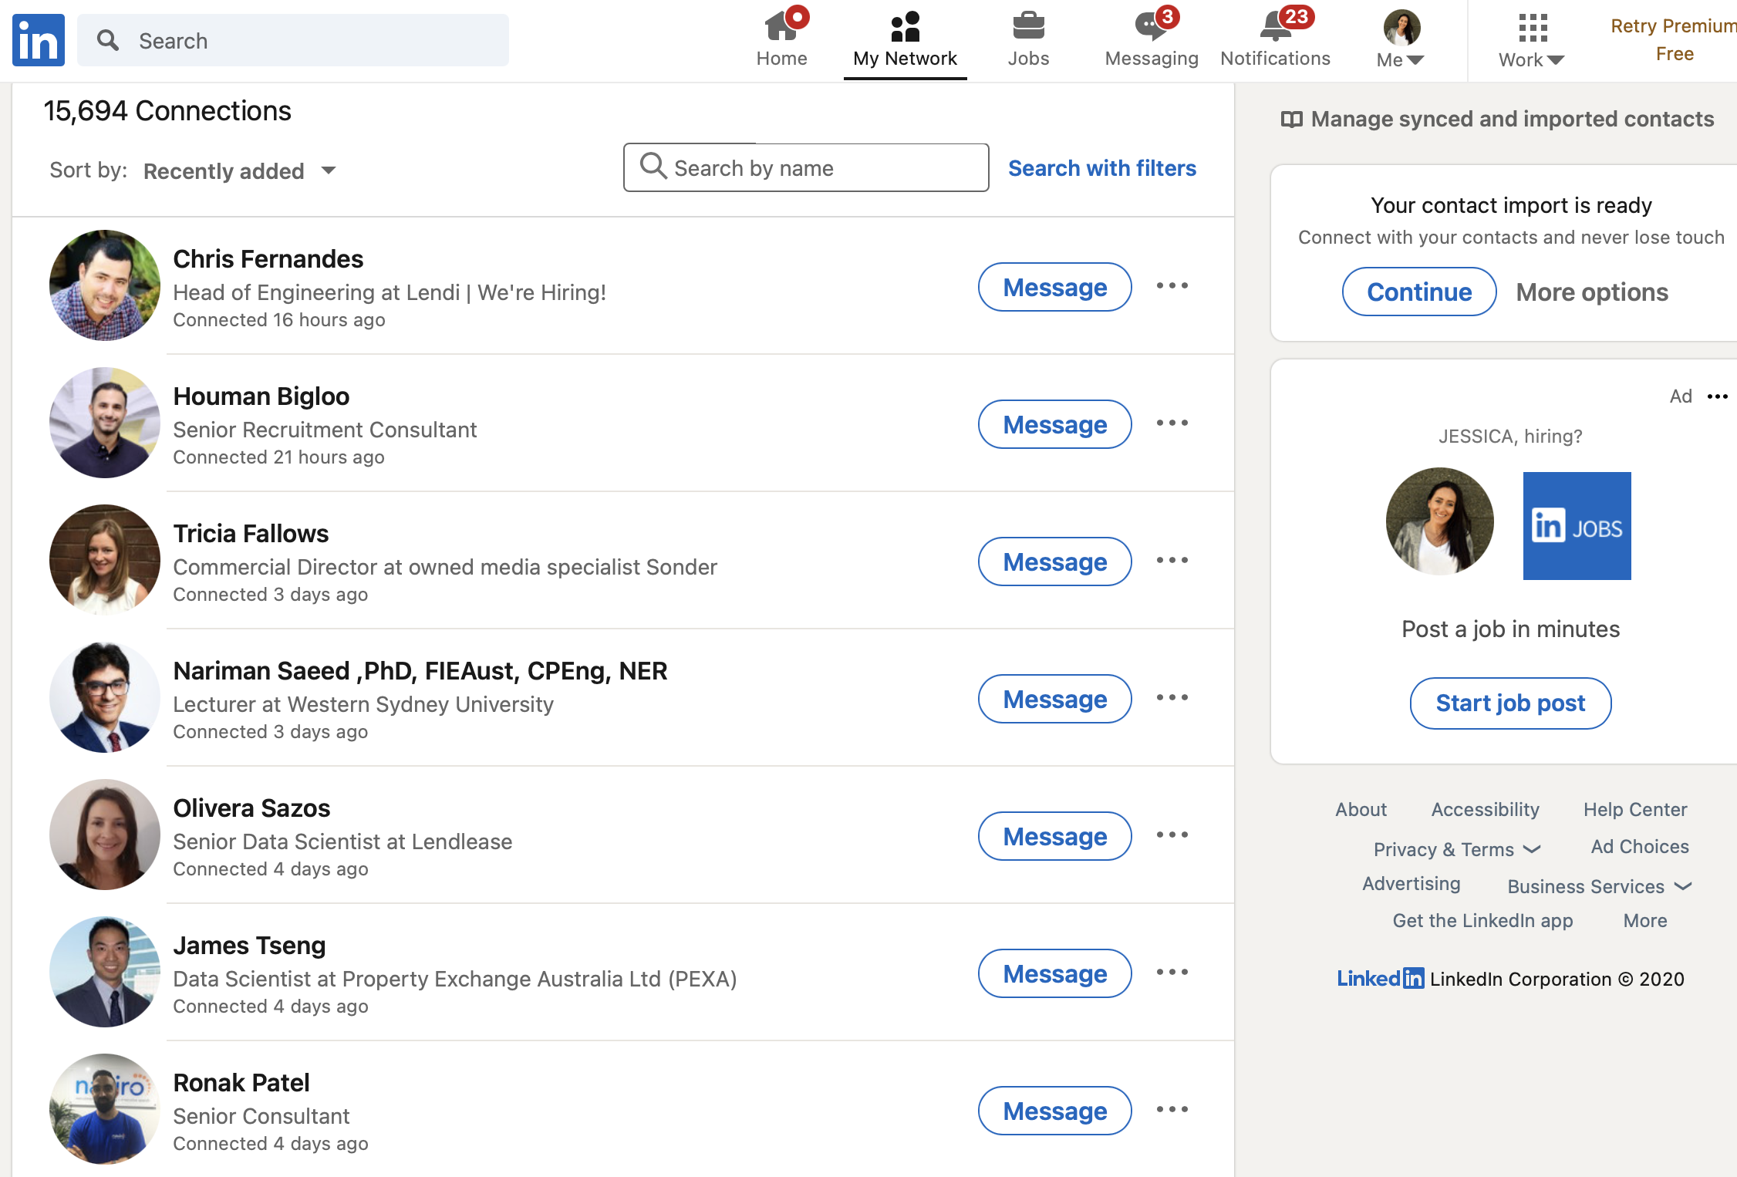
Networking using LinkedIn
Stay in touch as your network grows
Do people favours!
Like, Comment, Share...

Slide 35

Create an ACTIVE online presence!
Passive (Research)
Looking at people related to you or where you are going Looking at what other people are saying / doing Reading Blogs
Researching companies
Active (Communication)
Communicating = liking / sharing / asking / blogging / tweeting & retweeting / content creation

Slide 36
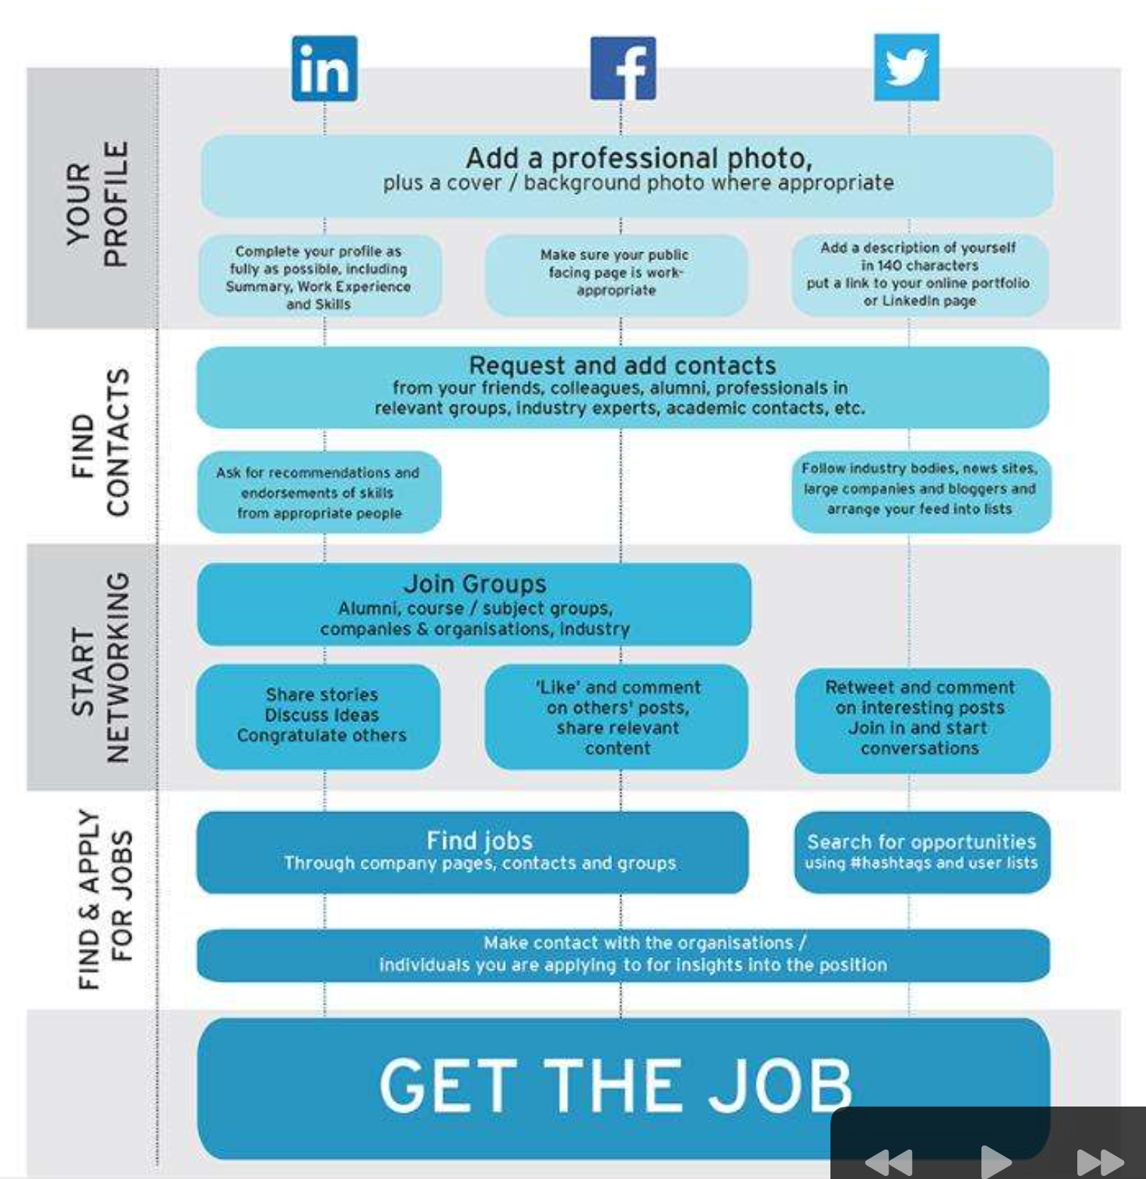
Social Media for job search summary

Slide 37
Be Proactive
Where would you love to work?
Who hires people like you?
Who needs your skills ?
Be proactive. Don’t just wait for a job to be advertised
Use LinkedIn to connect with prospective recruiters & hiring managers.
Engage with their posts on LI
Pick up the phone and introduce yourself

Slide 38
Interview Preparation
Knowledge is key!
Read the job description
Research the company
Understand who you are meeting, their role and their style
Ask how best you can prepare for the interview. Is it a skills based interview, technical interview or a behavioral based interview
Prepare relevant questions to the interviewer
“I would love to understand how you see the company core values coming to life”
“What have you enjoyed most about working at X”
“What are some of the key challenges your team are work on at the moment”

Slide 39
Common Interview Questions
See the “real” reason for the question. Eg What Tools Did You Use in a Recent Project and Why? So use this question to show that you not only have a rationale for choosing specific technologies over others, but also have the communication skills to explain your decision.
How would you describe yourself?
Why do you want to work here?
What interests you about this role?
What motivates you?
What are you passionate about?
Why are you leaving your current job?
What are your greatest strengths?
What are your greatest weaknesses?
What are your goals for the future?
Can you tell me about a difficult work situation and how you overcame it?
Can you tell me a bit about your experience using Python ?
Could you tell me about a recent project you worked on?
What is your salary range expectation?
Why should we hire you?
Do you have any questions?

Slide 40
STAR Technique
Situation: Describe the context in which you performed
In setting the situation, you are telling your listener when or where this event took place. For example, “We were working on a six-month contract for a high-value client, when our agency merged with another, larger firm…”
Task: What was your task or responsibility in that situation.
What was your role in this situation? For example, “It was my role to lead the transition for my group while also communicating with our client to keep the project on track.”
Action: How did you complete the task or challenge
What did you do? For example, “I set up weekly check-ins with the client to update them on the progress of the merger. This cemented an important level of trust between us. I also had regular one-on-ones with each person on the team, both to assess how they were handling the change and to make sure we would meet our deadlines.”
Result: What was the outcomes, results, Learnings generated by the action taken?
What did your actions lead to? For example, “We ended up completing the project on time, meeting all of their specifications. It was incredibly rewarding to navigate a lot of change and succeed under pressure.

Slide 41
Video Interviews
Find a quiet, private, well-lit place, free from possible interruptions.
Ensure your internet connection is stable.
Check that your computer’s audio is working.
Test your computer’s webcam.
Close any unnecessary web browser tabs and applications.
Dress professionally .
Have a pen, notepad and copy of your resume on your desk.
When listening, nod and smile to show you are engaged.
Use hand gestures when appropriate.
Place your phone in silent mode.

Slide 42
“Tell us About yourself?”
B Background
A Achievements/Awards
G Goals
S Skills/Strengths/Passions
An experience commercial builder recognised for my work at the Australian Master Builders Awards where I won house of the year for NSW in 2019. Recently I have completed a Bachelor of Architecture and am looking to further my career as an Architectural Designer. Some of the key skills I bring to a prospective employer are 10+years site management experience, strong understanding of Australian building requirements, Strong experience using CAD.

Slide 43
Dress Code
Dress to Impress - First impressions count
Ask what the Dress Code is at the company
Dress how the company would dress or more formally.
Things to think about
Clean and pressed.
Hair brushed and tidy.
Personal hygiene - Body Odor, Smoking etc

Slide 44
Pre-selection
Many organisations utilise a job pre-selection formal test that in these Assessment phase of the application process
GallUp (personality, values) Prepare for the Gallup's StrengthsFinder Personality Test
Revelian (cognitive, numerical ability, etc). Revelian assessments are commonly used by various govt agencies. Practice Revelian Tests - 20 Tests & 267 Questions
Key words. Key words. Key Words!

Slide 45
Follow up email
Always send a follow up thank-you email thank the individual for their time.
Be brief, friendly, and conversational.
Restate your interest in the job
Add any relevant information that you may have forgotten to say in the interview.

Slide 46
Internships & Volunteering
Taking a paid or unpaid internship or volunteer work can give you the essential experience that’s required to get a job.
https://aprintern.org.au/available-internships/
https://www.insidesherpa.com/

Slide 47
Salary Negotiation
Keep in mind that employers have a budget and its ok to ask what that is!
“What is the budget that you have allocated for this role”
Don’t price yourself out of of the market
Do you research to understand average salaries
Utilise Recruitment Agencies to do the negotiations on your behalf
If your working directly with a company and get asked your salary expectations
“I have been exploring opportunities between X & Y however I am negotiable for the right opportunity”
“Money is not a key motivator for me in landing a job with X so I would say I am negotiable. What is this the salary aligned to this opportunity”

Slide 48
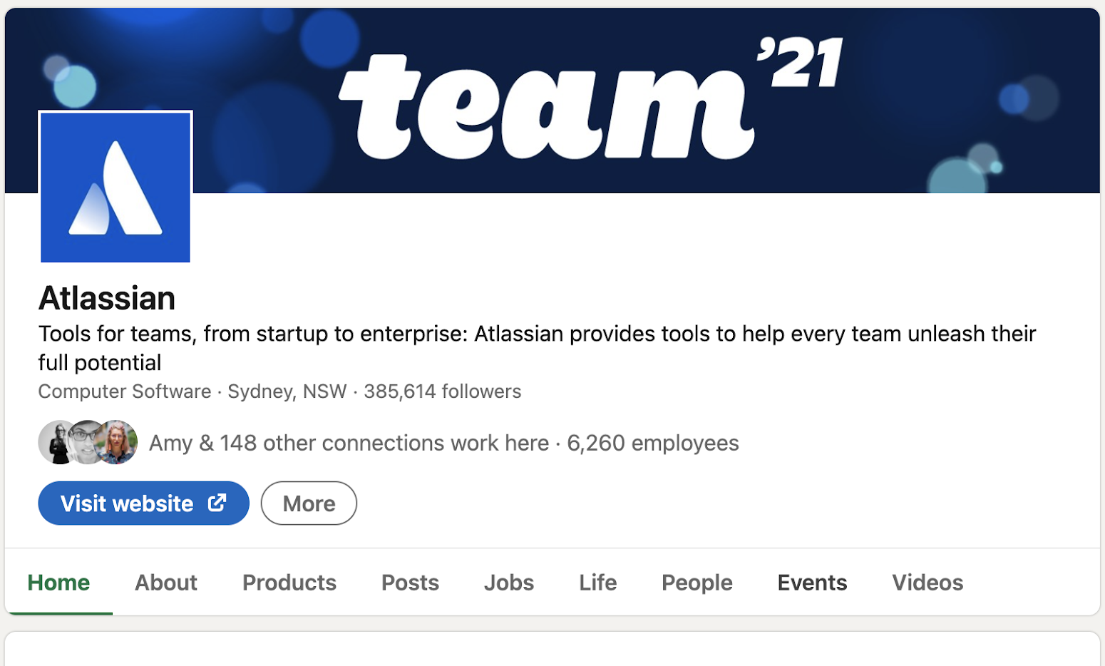
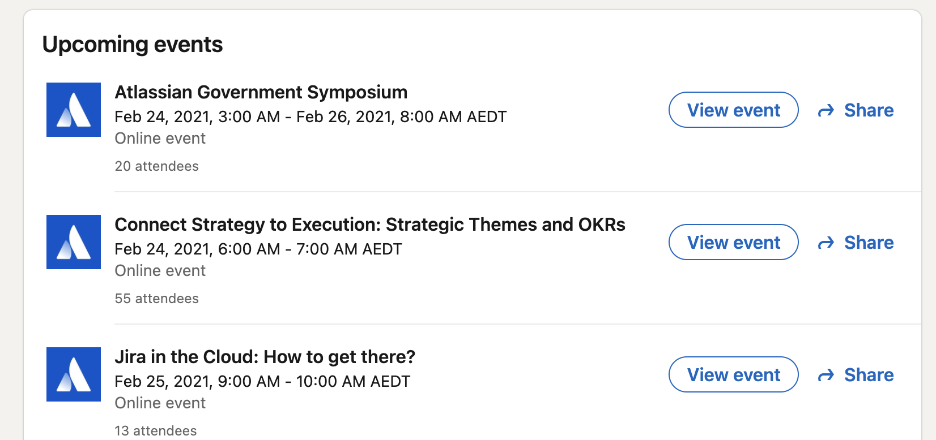
Networking Groups & Events
Meetup.com
EventBrite
Company Websites
Industry Groups / Websites

Slide 49
Networking / Hiring Events
Dress to impress - Consider Networking Events a prospective interview.
Be yourself - Networking events are meant as jumping-off points for relationship building.
Introduce yourself to the organizer - A great way to get to know who is involved and get introduced to others
Ask great questions - The only way to get to know someone else is to ask them genuine and thoughtful questions
Be engaged - . Keep eye contact with your conversation partner. Nod your head. Consider your body Language
LinkedIn - Ask to connect with them on LinkedIn
Update your Job Tracking Sheet - Note the event. The people you have met / companies they work for

Slide 50
Mentors
Forming a relationship with someone in your industry that has more knowledge and experience that you
The exchange of expert advice, and provision of guidance, emotional support, and motivation from a role model.
Helps with exploring career pathways, setting professional goals, and developing contacts.

Slide 51
Liaising with Mentor or Business Contact
Select questions that are appropriate for your target career, stage of decision-making, person you are meeting.
Use some of the following questions or make up your own.
What is a typical day (or week) like for you? What do you like most about your role?
What do you like least about your role? What kinds of problems do you deal with?
What kinds of decisions do you make? How does your position fit within the organization/career field/industry?
How does your job affect your general lifestyle? What current issues and trends in the field should I know about/be aware of?
What are some common career paths in this field? What kinds of accomplishments tend to be valued and rewarded in this field?
How did you become interested in this field? What related fields do you think I should consider looking into?
How did you become interested in this field? How did you begin your career?
How do most people get into this field? What are common entry-level jobs?
What steps would you recommend I take to prepare to enter this field? What skills, abilities, and personal attributes are essential to success in your job/this field?
Can you recommend trade journals or professional associations? What advice would you give someone who is considering this type of job (or field)?
If you could do it all over again, would you choose the same path for yourself? If not, what would you change?
Is there anyone else you would suggest I connect with ?

Slide 52
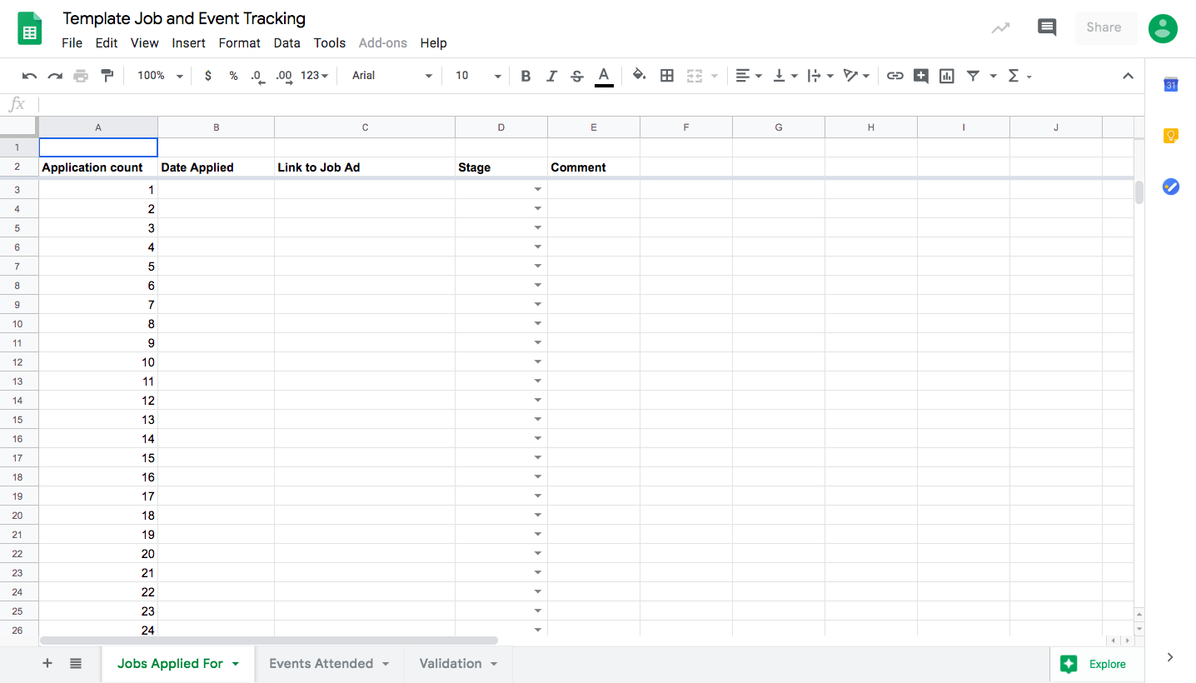
Job Application and Event Tracking

Slide 53
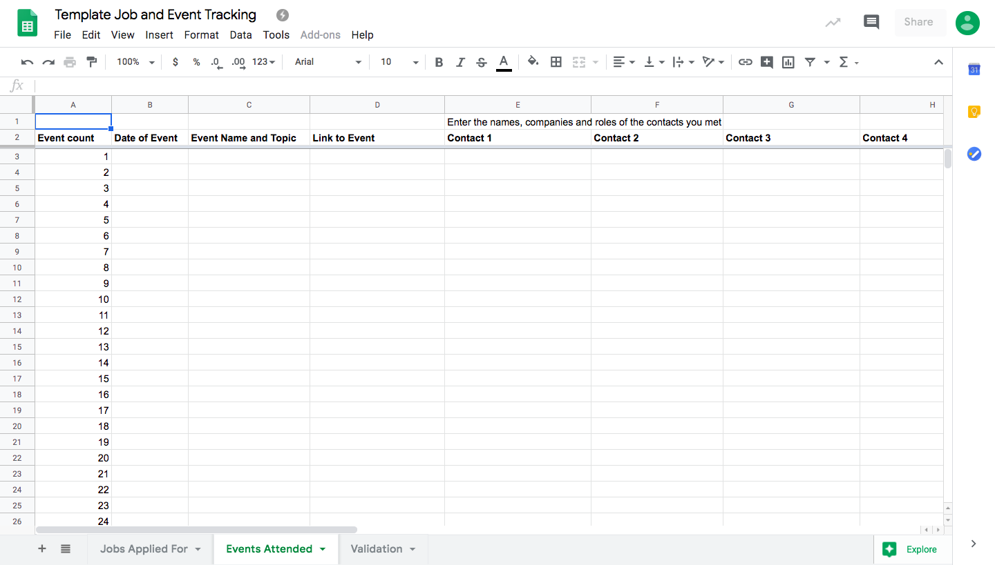
Event Tracking

Slide 54
Summary
What is the Job Outcomes Program and what do I need to do?
Resume & Cover Letters
IOD Job Board
Social Media for Job Searching
Understanding your Digital Footprint
LinkedIn Profile
Job Search Using LinkedIn
Growing your Network
Be Proactive - Top 20
Interview Preparation & Execution
Dress Code
Follow up Emails
Internships & Volunteering
Salary Negotiation
Networking & Hiring Events
Mentors
Job and event tracking sheet

Slide 55
Questions ?
Jessica Haines
Head of Talent
Book a meeting: https://app.hubspot.com/meetings/careers-advisor-iod/job-outcomes-career-coaching-call

Slide 56
End of presentation

